Slide 1
PRESENTATION
2022

Slide 2
About us
> OPTIMA Power was founded in 2007 in city Modriča, located in the northen part of BiH in Republic of Srpska, approx. 16 km from the border with Croatia and the European Union
> OPTIMA Power as company has a global focus to provide supervision, overhaul and delivery of spare parts for power industry
> OPTIMA Power provides services for the overhaul of power Units: TURBINE, GENERATORS, COMPRESSORS and PUMPS.

Slide 3
HISTORY
2007. Was found in city Modriča, Republic of Srpska - BiH
2008. Certificated solution partner for original manufacturer ALSTOM – BBC/ABB.
2009. Over 90% of the company turnover generated from export
2010. Subcontracting projects for ALSTOM Power Service u Germany, Serbia, Portugal and Spain
2010. Spare parts solution partners for ALSTOM Power / GE Power in Portugal
2012. Re-engineering turbine spare part for Chinese OEM - Shanghai Turbine in Turkey
2013. Capital investment in administrative centre »Optima power Head office« 400 m²
2017. Investment in production facilities for CNC processing, Optima Power machining park” on 1000 m²
2019. Certificated company of Comply Works in according with GE hazard management system
2020. Solution partner from ITH for Balkan
2021. Solution partner from Metal Expert for Balkan

Slide 4
OUR PORTFOLIO
> Consulting > Supervision > Re-engineering and designing > Overhaul works > Manufacturing services > Additional service

Slide 5
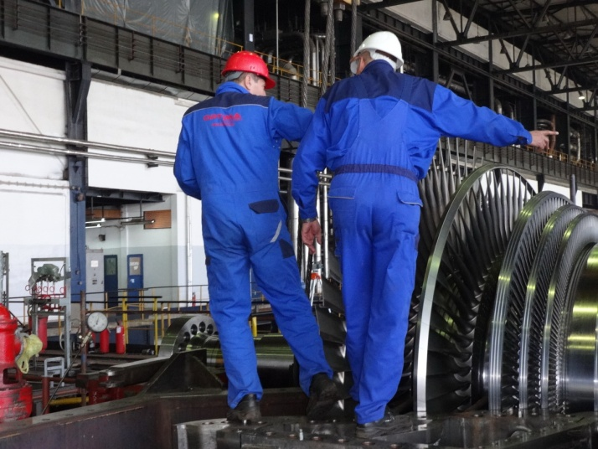
CONSULTING
> Technical consulting– TFA
> Project Management
> SCC training (Safety Certificate Contractors)
with TÜV Thüringen partnership
> EHS (Environment, Health, Safety) services, verified from Comply
Works for GE hazard management system

Slide 6
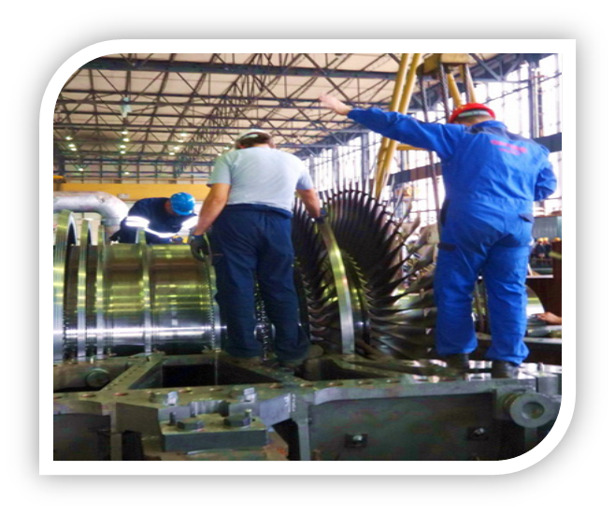
SUPERVISION
> Site Managers
> EHS management
> Supervisors on turbine, generator, valves, hydraulics ,compressors, pumps
> Low speed rotor balancing
> Special services like blading, mobile machining

Slide 7
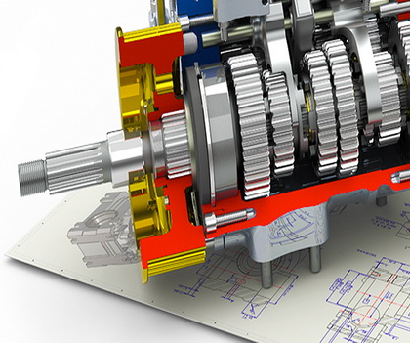
ENGINNERING AND DESIGN
> 3D modelling of mechanical components and structures
> FEM analyses of mechanical construction
> Technical and workshop drawings
> Designing system
> Spare parts OEM manufacturers
> Engineering, design and manufacturing of
frames for rotor and casing turbines and generators

Slide 8
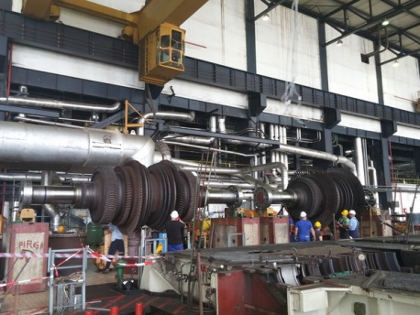
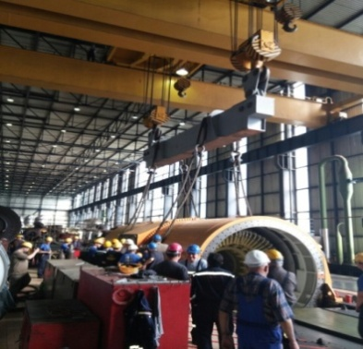
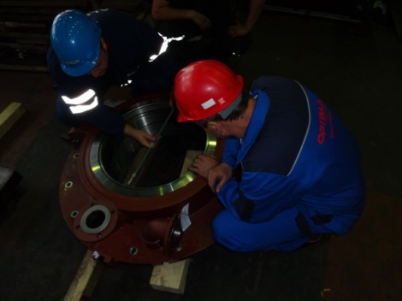
OVERHAUL
> Steam turbine 15 MW – 700 MW (BBC, CEM, ABB, Alstom, LMZ, KTZ, Shangai Turbine)
> Turbo-compressors (LMZ, Worthington, Jugoturbina)
> Boilers turbo feed pumps (KSB, BMZ)
> Generator (BBC/ABB/ALSTOM, ETM, Rade Končar, Elektrosila)
> Mobile machining (Honing)

Slide 9
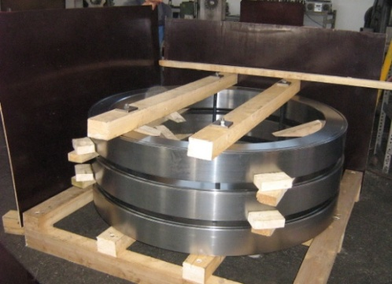
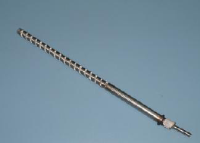
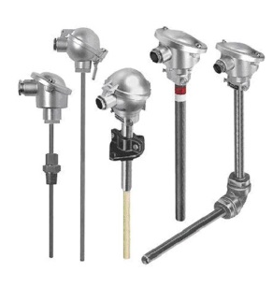
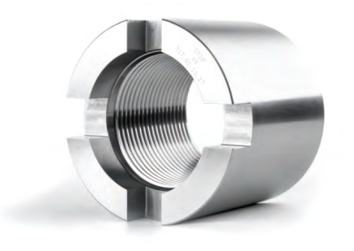
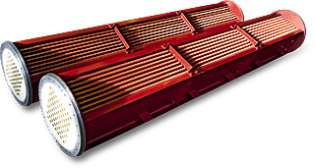
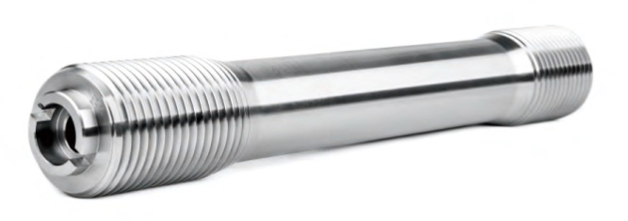
MANUFACTURING SERVICES
Original spare parts OEM Alstom (BBC/ABB), GE, Shanghai Electric, LMZ, KTZ (turbine) and own production service:
> Bolts, screws, nuts, sleeves, shrink rings, generators coolers, oil coolers, generator sealing rings, shafts, spindles, shrink rings and bearings for turbine or generator
> Frame for transport of turbine, generator and another components
> Electrical bolt heaters
> Thermo couples

Slide 10
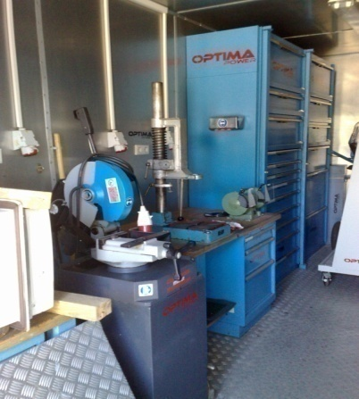
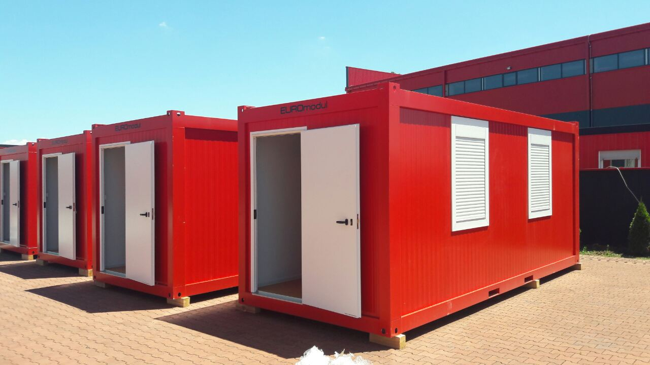
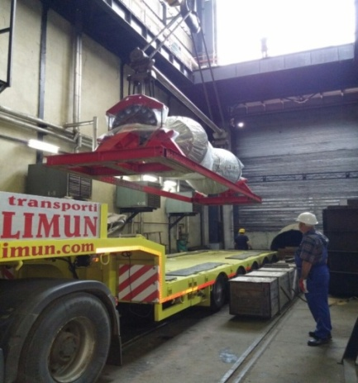
ADDITIONAL SERVICE
> Rental services of fully equipped tool containers with hand tools and measuring equipment, office containers, changing rooms, workshop containers with special tools for cleaning and sundblasting
> Transport skid for transport services of HP, IP, LP Turbine rotors and other components
> Special transport domestic and international
> Clasic domestic and international transport

Slide 11
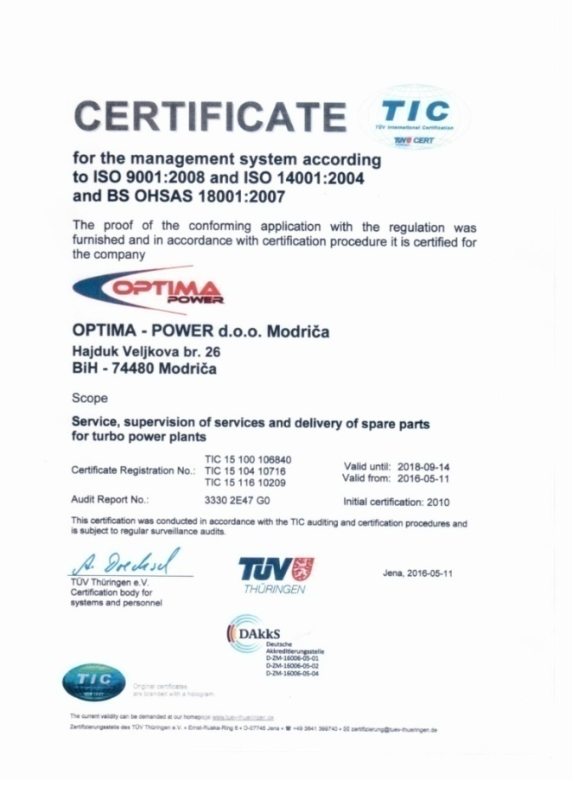
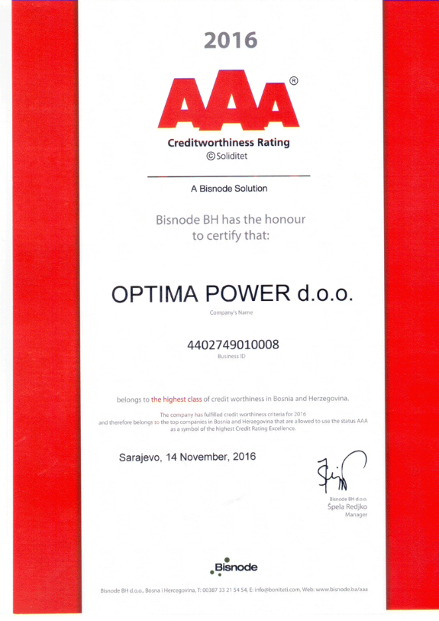
CERTIFICATES
>
> ISO 9001
> ISO 14001
> BS OHSAS 18001
> AAA Creditworthines rating

Slide 12
REFERENCES
Alstom Power - Germany
GE Power – Germany, Israel
TPP Nikola Tesla A, Obrenovac - Serbia
TPP Nikola Tesla B, Obrenovac - Serbia
Optima Group – Refinery oil Modriča- BiH
Alumina Zvornik – Production alumina, zeolit, hydrat - BiH
TPP IÇDAŞ Çanakkale - Biga - Turkey
TPP Termica de Meriama Lousa de Arriba - Spain
TPP Sines - Setubal - Portugal
TPP Pego - Santarem - Portugal
TPP DSW SDOM - Israel
TPP Rutenberg - Israel

Slide 13
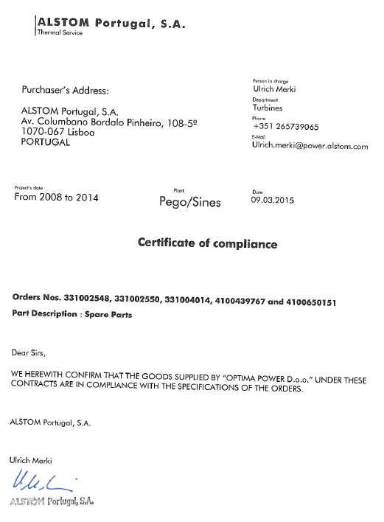
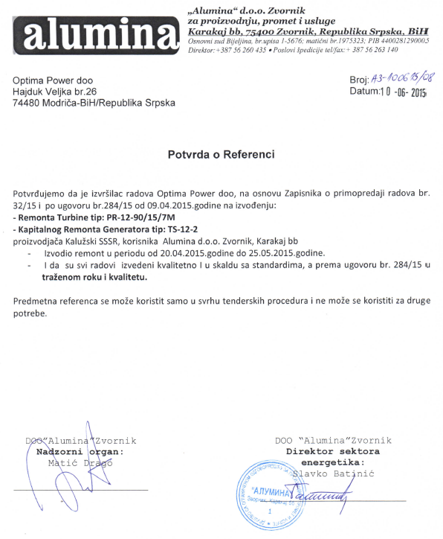
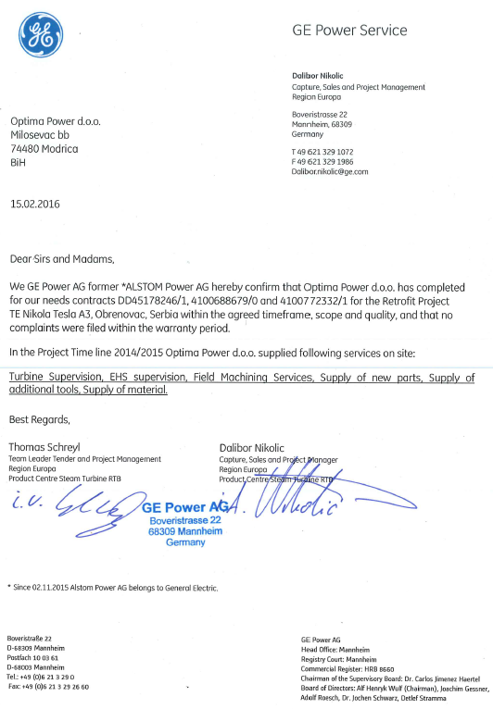
EXAMPLES OF REFRENCE

Slide 14
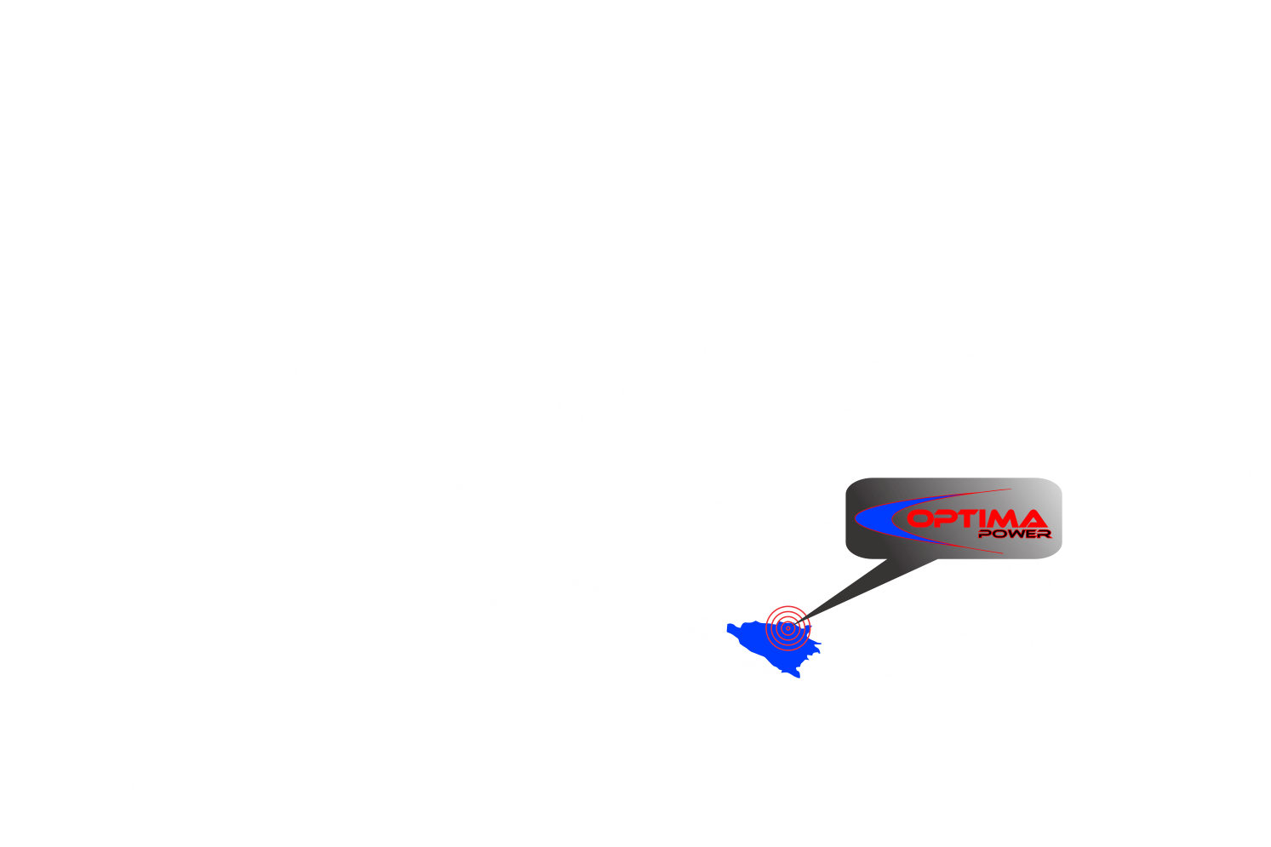
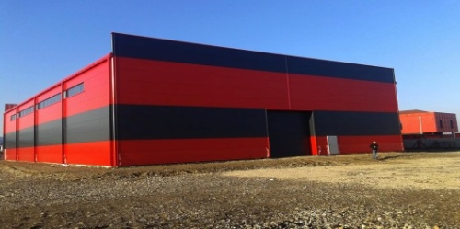
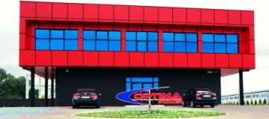
LOCATION

Slide 15
CONTACT
Head Office:
Obala 49, Kladari Donji
74480 Modriča
Bosnia and Hercegovina
Tel: +387 (0) 53 820 240
Fax: +387 (0) 53 820 240
E-mail: service@power-optima.com
Web: www.optima-power.ba

